Slide 1
Servlets

Slide 2
Contents:-
Client server architecture
Overview of applets and CGI
Servlet hierarchy
Servlet types
Tasks of servlet
Lifecycle
Containers
Advantages

Slide 3
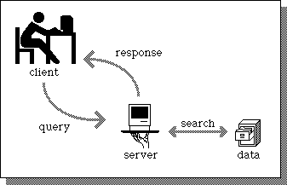
Client server Architecture :-
Accessing static data

Slide 4
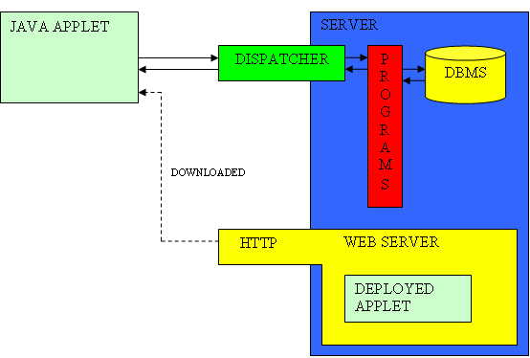
Applets :-
    Small application written in java having better GUI but unlike an application, APPLETS can't be executed directly from Operating system
    Program output directly embedded into webpages, browser point to output and byte code downloaded to client's browser and then executed
    Generally serves one client at a time.
    Fast and easy way for small programs
    For large programs heavy(time consuming, more space)

Slide 5
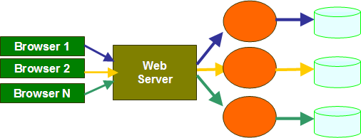
CGI :- Common Gateway Interface
  Process based:- For each request it starts a new process.
  CGI program needs to be loaded and started for each CGI request.
  Database communication must be re-opened for each requests
  No cookie handling, session tracking

Slide 6
Servlets:-
  Thread based:- Only instance created which answers all requests concurrently instead of each process creation request
  Runs on server side
  Dynamic response based on user's request
  So, applets which run on servers side of connection
  Typically run on the HTTP protocol(an asymmetrical request-response protocol) where client sends a request message to the server, and the server returns a response message according to request.
Servlet
Browser 1
Web
Server
Browser 2
Browser N

Slide 7
Performance superior to CGI as no new process creation for each client request.
Due to multi-threading capability, hundreds and even thousands of users can access the same servlet simultaneously without affecting load of the web server.
Platform independent
Both Presentation and Logic are separate while using servlets
An extension of the Java platform, they can access whole Java API, access to the rich Java library that will help speed up the development process.
Run under secure environment sandbox

Slide 8
Hierarchy of the servlet :-
Servlet
|
GenericServlet
|
HttpServet
Client
GenericServlet
request
    Server
  service ( )
response
Browser
HTTPServlet
doGet
request
( )
HTTP Server
    service ( )
response
doPost
( )

Slide 9
Generics Servlet:- javax.servlet (package)
extends javax.servlet.Servlet class
contains protocol independent classes and interfaces so can handle any type of requests
Implements Servlet, ServletConfig and java.io.Serializable interfaces
No support for cookies, setting Response headers, Session tracking are not supported
An Abstract class, so you need to implement all the unimplemented methods

Slide 10
Http servlet :- javax.servlet.http (package)
contains classes and interfaces that are specific to HTTP
Extends HttpServlet class and implements java.io.Serializable.
Inherits properties of Generic Servlet
HttpServlet can process multiple clients requesting from multiple HTML forms.
subclass of HttpServlet override one method from doGet(), doPost(),doPut(), doDelete(), init(), destroy(), getServletInfo()

Slide 11
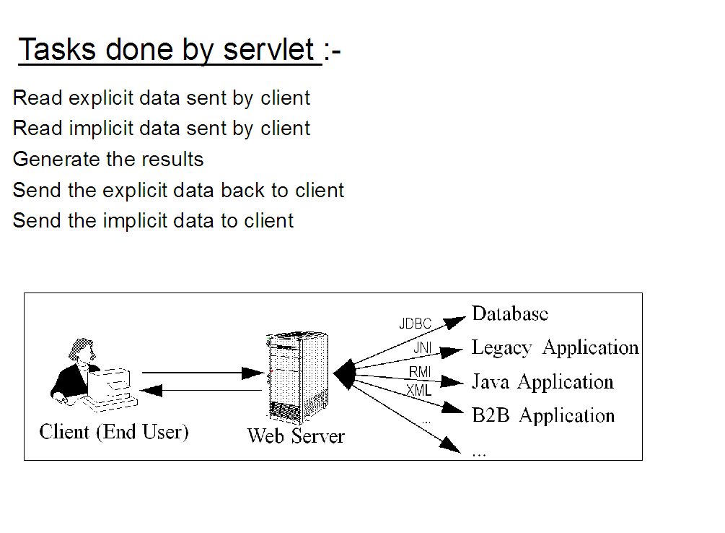
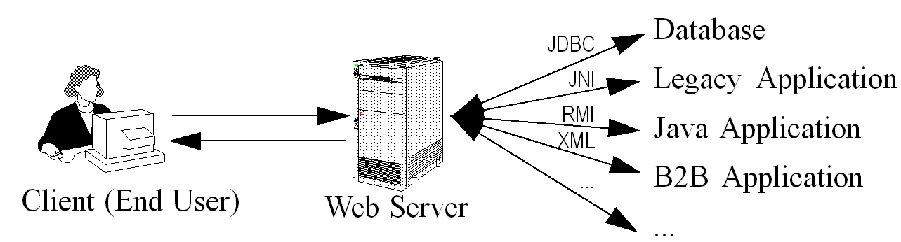
Tasks done by servlet :-
Read explicit data sent by client
Read implicit data sent by client
Generate the results
Send the explicit data back to client
Send the implicit data to client

Slide 12
HIDDEN
Form data
Request headers
HTML content
status codes and response headers

Slide 13
Lifecycle:-
  Controlled by the container in which the servlet has been deployed. When a request is mapped to a servlet, the Web container performs the following steps:-
  Loads the servlet class.
  Creates an instance of the servlet class.
  Initializes the servlet instance by calling the init method.
  Invokes the service method, passing a request and response object.

Slide 14
HIDDEN
container loads servlet when request is made with reference of web.xml
After loading of the servlet, the container creates the instances of the servlet.
container calls the init() method and passes the parameters to the init() method.
only once throughout lifecycle
Available for service if loaded successfully otherwise the servlet container unloads the servlet
Creates seperate threads for each request.
The sevlet container calls the service() method for servicing requests.
According to kind of requests calls the appropriate method (doGet() or doPost()) and sends response to the client using the methods of the response object.
Wait for another request if no more requests are there calls the destroy().
Releases all the resources associated with it, JVM claims memory associated with resource for garbage collection.
Container calls it once, we can any number of times.

Slide 15
container loads servlet with reference of web.xml when request is made
creates the instances of the servlet and call init() passes parameters.(once)
If loads successfully, available for service. Container calls the service() method for servicing requests.
Creates separate threads for each request.
According to kind of requests calls the appropriate method (doGet() or doPost()) and sends response to the client using the methods of the response object.
Wait for more requests, if no more, destroy(), Container calls it once, we can any number of times.
Release resources acquired by it.

Slide 16
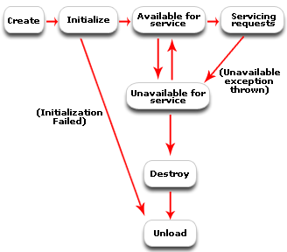
Concurrent
Threads
of Execution

Slide 17
Containers :-
Interacts with web servers and java servlets
Servlet containers contain servlets, filters, listeners, etc. and manages their state and lifecycle.
HTTP Request
Servlet
Container
Servlet
Browser
HTTP
Server
HTTP Response
Static
Content

Slide 18
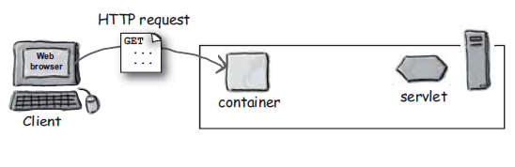
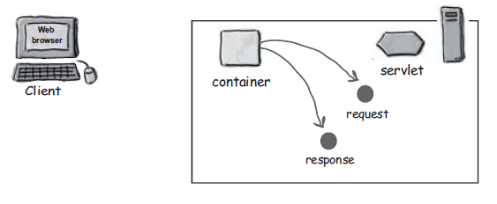
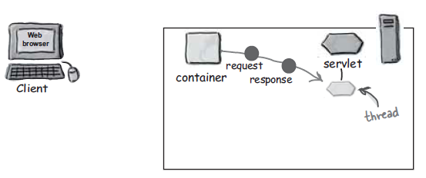

Slide 19
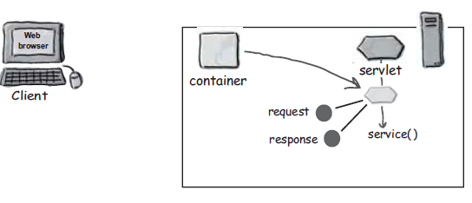
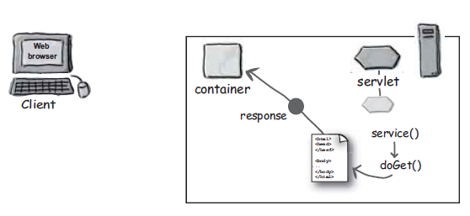
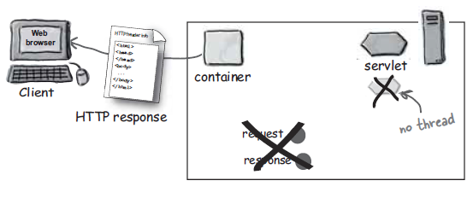

Slide 20
web.xml :-
A web Deployment descriptor which describes how a component, module or application should be deployed.
Servlet mapping
Contains Welcome files, initialization parameters, defines tag libraries
Session configuration,Cookie management
Security and Authentication

Slide 21
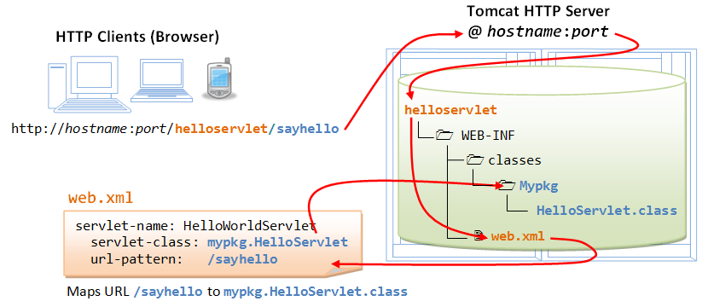

Slide 22
Advantages :-
Secure communication between Web server and servlet(sandbox),
JSP Support,
To add dynamic control from server side uses HTTP Protocol
Inexpensive
Portable
Cookie management,
Session tracking
Handle multiple clients at once

Slide 23
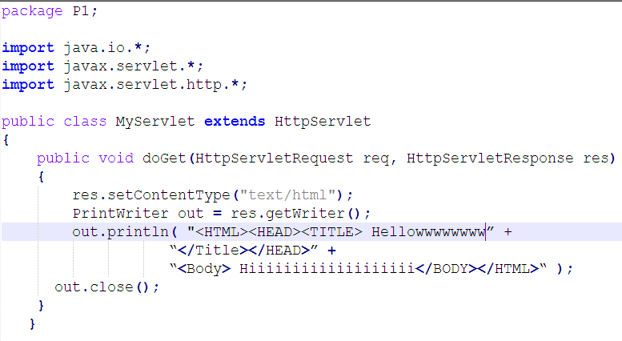

Slide 24
JSP

Slide 25
Contents:-
Overview
Architecture
Lifecycle
JSP Syntex
Predefined Variables

Slide 26
HTML :- same and static content
Technology that lets us mix static content with dynamically generated HTML pages.
Fast way to create web pages that display dynamic content
Doesn't give you anything that you can't do with servlets.
Compact and easier to understand.
Code enclosed in out.println() statements of servlet
A template like structure in which logic is embedded.

Slide 27
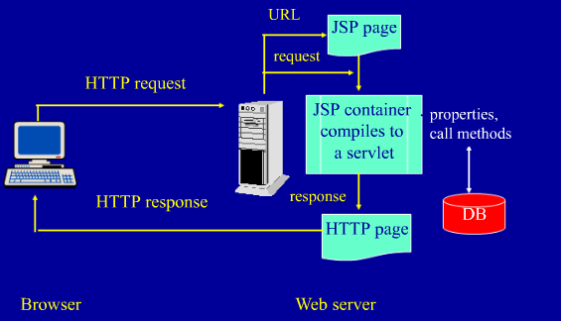

Slide 28
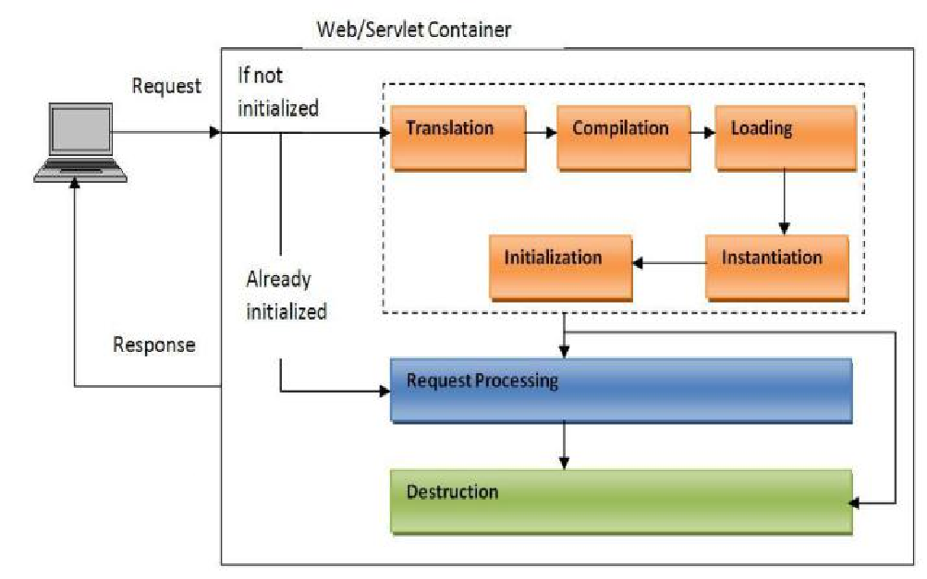
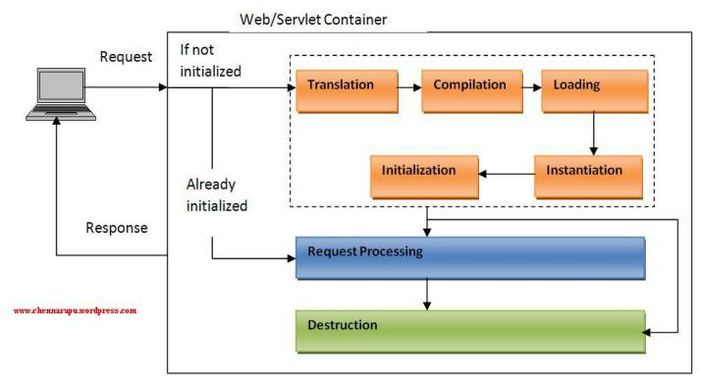
JSP LifeCycle

Slide 29
When a web container receives a jsp request, it checks for the jsp’s servlet instance. If no servlet instance is available or if it is older than the jsp, then, it creates the servlet instance using these stages :-
Translation
Compilation
Loading and Initialization
Instantiation
Request Handling
Destroying

Slide 30
JSP Expressions
Used to insert values of Java methods directly into the output
Such type of expressions in <%=. . . %> tags will be evaluated and printed to HTML
<HTML>
<HEAD>
      <TITLE>The Current Date and Time</TITLE>
</HEAD>
<BODY>
tym is <= new java.util.Date() %>
  </BODY>
</HTML>

Slide 31
JSP Scriptlets
Don't produce a value directly
Just a java code in <% . . . %> tags in HTML, inserted into servlet exactly as written
Contain any number of statements or method declarations
<%
java.util.Date now = new java.util.Date();
%>
<HTML>
  <BODY>
The time is now <%= now %>
</BODY>
</HTML>

Slide 32
JSP Declarations
To declare values and methods.
Syntax :- <%! ….. %>
i.e. <%! int i=0; %>

Slide 33
JSP Directives
Syntax :- <%@ directive attribute="value" %>
3 types :- page, include, taglib
Page:- to add special feature (import, extends, info)
    <%@ page content type="text/html"%>
Include:- to include the contents of any other file
    <%@ include file="index.html" %>
Taglib :- to define a tag library that defines many tags.
    <%@ taglib uri="www.javatags.com/tags" prefix="mytag"%>

Slide 34
Predefined variables
For simplification of coding,
    Request
    Response
    Out
    Session
    Actions(to construct XML syntax):-
        setproperty
        getproperty
        foreward

Slide 35
  The
            End

